Slide 1
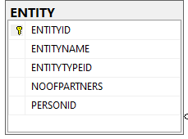
Entity
Entity table will be the entry table
EntityTypeID will be deciding factor for entity type from look up table
ENTITYLOOKUPID | CATEGORY | LOOKUPVALUE | DISPLAYORDER
14 | ENTITYTYPE | Individual Entity | 1
15 | ENTITYTYPE | Firm | 2
16 | ENTITYTYPE | Company | 3
17 | ENTITYTYPE | AOP BOI | 4
Primary person of the entity will be in the person id column

Slide 2
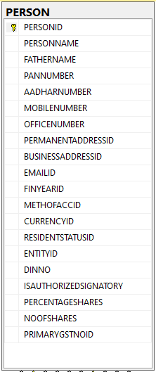
Permanent Address ID and Business Address ID will refer to address fields
FINYEARID will be from look up table
ENTITYLOOKUPID | CATEGORY | LOOKUPVALUE | DISPLAYORDER
4 | FINYEAR | 2020~2021 | 1
5 | FINYEAR | 2021~2022 | 2
6 | FINYEAR | 2022~2023 | 3
METHOFACCID will be from lookup table
ENTITYLOOKUPID | CATEGORY | LOOKUPVALUE | DISPLAYORDER
7 | METHODOFACCOUNTING | Mercentile | 1
8 | METHODOFACCOUNTING | Cash | 2
Similarly RESIDENTID and CURRENCYID are also from lookup
ENTITYLOOKUPID | CATEGORY | LOOKUPVALUE | DISPLAYORDER
9 | CURRENCY | INR | 1
10 | CURRENCY | USD | 2
11 | RESIDENT STATUS | Resident | 1
12 | RESIDENT STATUS | Non Resident | 2
13 | RESIDENT STATUS | Not Ordinarily Resident | 3
Secondary persons will have ENTITYID value filled
Primary GST NO ID references the main GST NO

